Slide 1
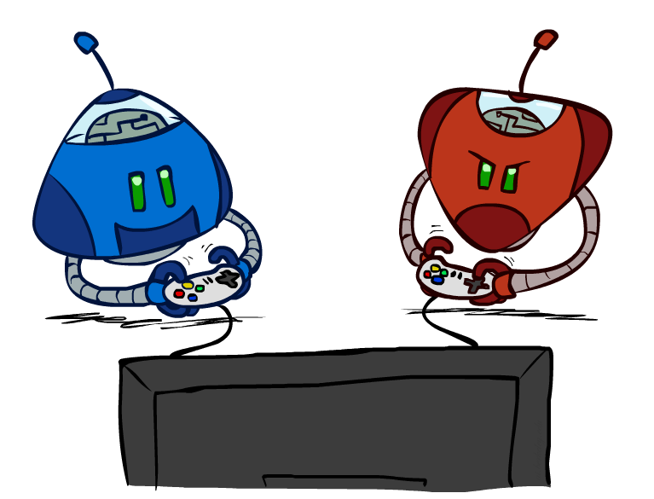
CS 188: Artificial Intelligence
Adversarial Search II
Instructor: Imtiaz Parvez
Utah Valley University
[Adapted from slides at ai.Berkley.edu]
Notes:
Please retain proper attribution and the reference to ai.berkeley.edu. Thanks!

Slide 2
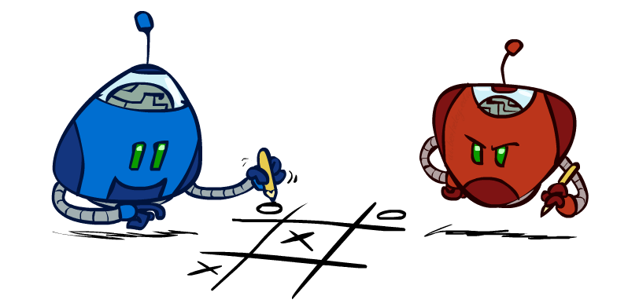
Additional Learning Outcomes
More SLOs
Model multiplayer adversarial games
Model games with chance
Model problems using Monte Carlo Tree Search
Implement the algorithms above

Slide 3
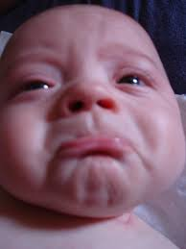
So far…
Focus on two-player, zero-sum, deterministic, observable, turn-taking games
Minimax defines rational behavior
Tactical: Minimax
Strategic: Evaluation Function for non-terminal states
Recursive DFS implementation
space complexity O(bm), time complexity O(b^{m})
Alpha-beta pruning with good node ordering reduces time complexity to O(b^{m/2})
Still nowhere close to solving chess, Go or StarCraft

Slide 4
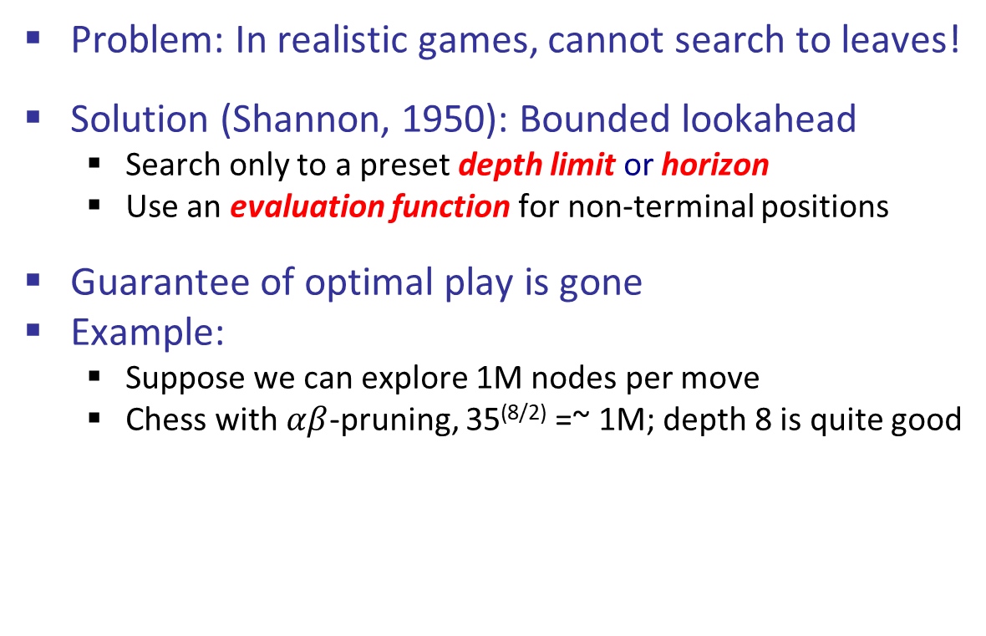
Recap: Resource Limits So Far
Problem: In realistic games, cannot search to leaves!
Solution (Shannon, 1950): Bounded lookahead
Search only to a preset depth limit or horizon
Use an evaluation function for non-terminal positions
Guarantee of optimal play is gone
Example:
Suppose we can explore 1M nodes per move
Chess with $αβ$-pruning, 35^{(8/2)} =~ 1M; depth 8 is quite good
max
4
-2
4
min
-1
-2
4
9
?
?
?
?

Slide 5
Recall Pacman Lookahead Demos
Depth 2
Depth 10 (Perfect Lookahed)
one dot and two ghosts
dot is about 8 steps away
Pacman cannot see actual eating
need to include distance to dots in eval
limited depth means
Minimax goes into a dead end and cannot escape even a simple ghost strategy
head towards red ghost!!!
Wait for blue to commit to one pursuit direction
go other way
eat the dot
Note also the horror you (human) feel
humans would take the safer strategy of waiting, not heading for blinky
minimax doesn’t care
WHY? Minimax is 100% certain its theory of the world is correct

Slide 6
Evaluation Functions
Evaluation functions score non-terminals in depth-limited search

Slide 7
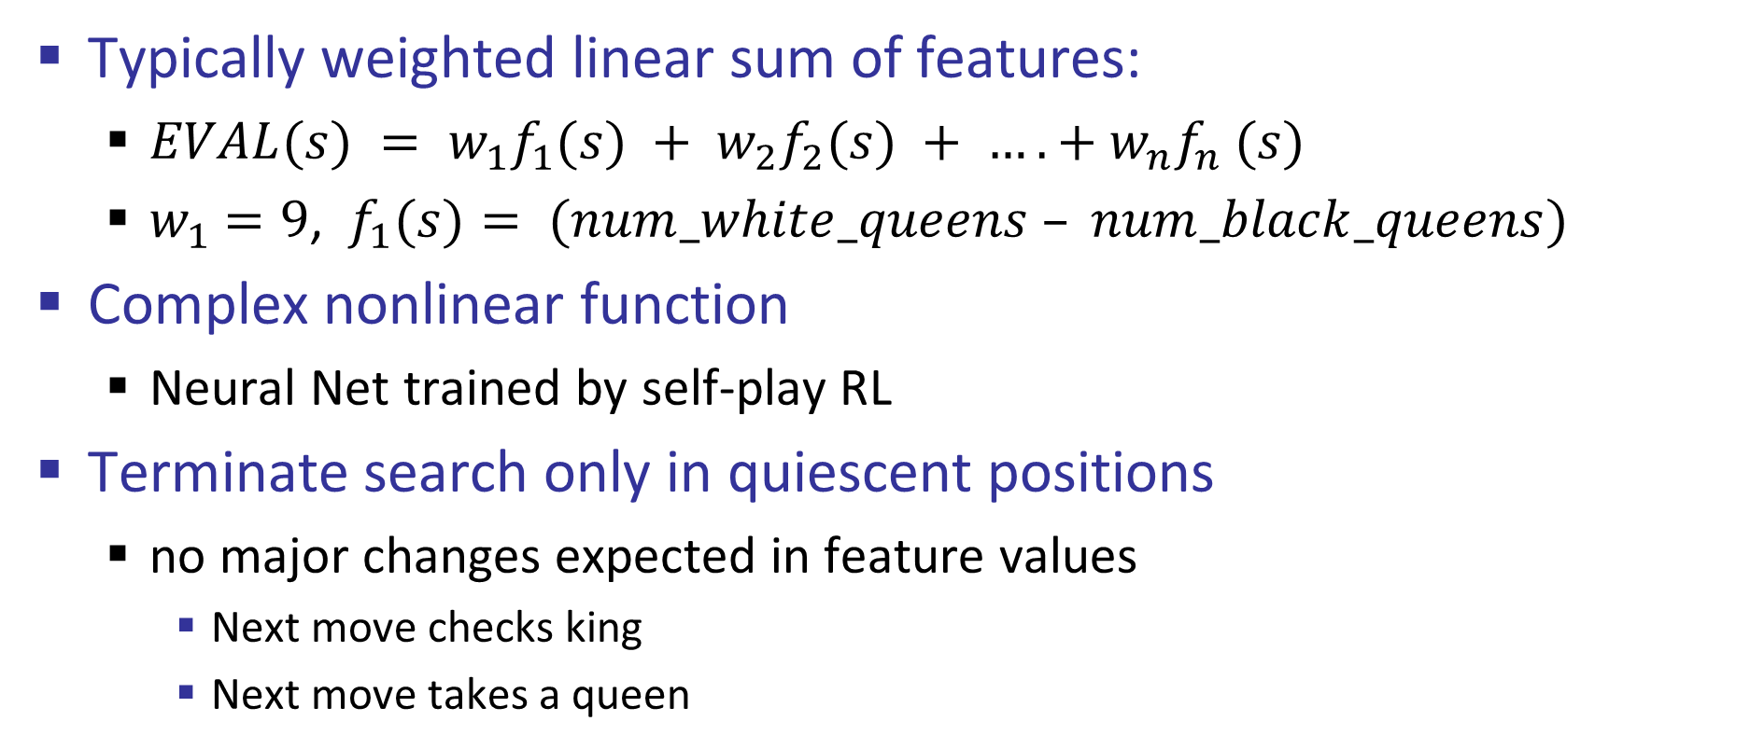
Evaluation Functions
Typically weighted linear sum of features:
$EVAL(s) = w_{1}f_{1}(s) + w_{2}f_{2}(s) + …. + w_{n}f_{n} (s)$
$w_{1}$ $=9$, $f_{1}(s)= (num_white_queens – num_black_queens)$
Complex nonlinear function
Neural Net trained by self-play RL
Terminate search only in quiescent positions
no major changes expected in feature values
Next move checks king
Next move takes a queen

Slide 8
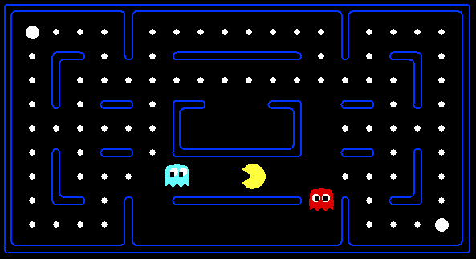




Evaluation for Pacman

Slide 9
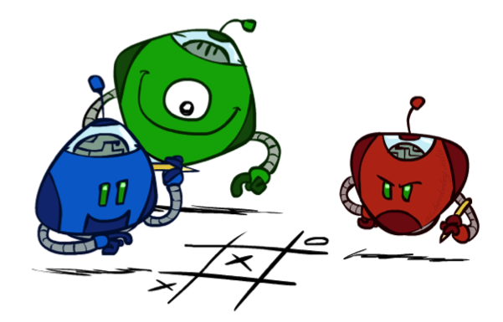
Generalized minimax
What if the game is not zero-sum, or has multiple players?
Generalization of minimax:
Terminals have utility tuples
Node values are also utility tuples
Each player maximizes its own component
Can give rise to cooperation and
competition dynamically…
8,8,1
8,8,1
7,7,2
0,0,7
8,8,1
7,7,2
0,0,8
1,1,6
0,0,7
9,9,0
8,8,1
9,9,0
7,7,2
0,0,8
0,0,7
Notes:
If both ghosts go the same way, pacman wins; if they go different ways, pacman loses

Slide 10
Emergent Coordination in Ghosts
Two ghosts equipped with minimax
Pacman gets his head handed to him.
EVAL function includes closeness to Pacman
final surrounding move comes from terminal state UTILITY function
This scenario
could be done with two-ghost state
is three-player minimax with both ghosts using min
Ghost coordination is emergent, not planned!

Slide 11
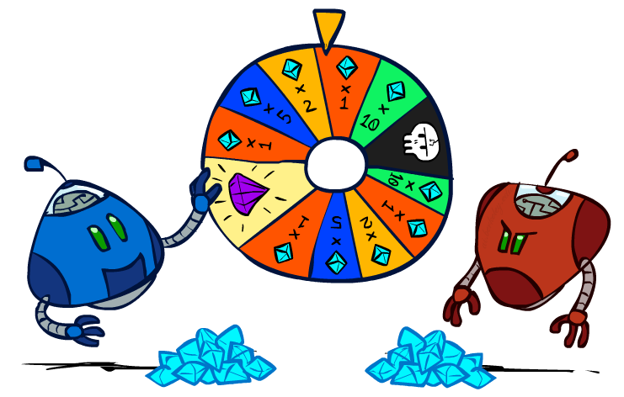
Games with uncertain outcomes

Slide 12
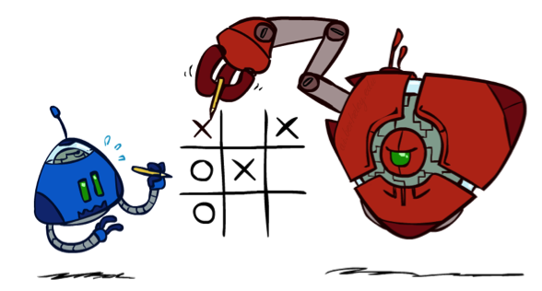
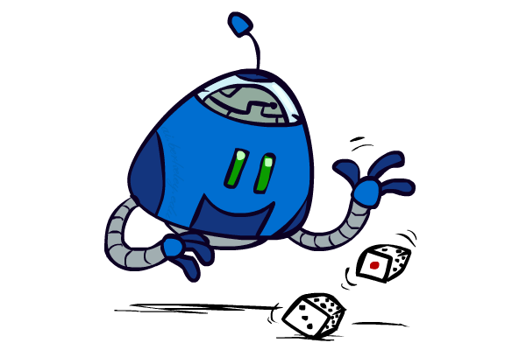

Chance outcomes in trees
10
10
9
100
10
10
9
100
Tictactoe, chess
Minimax
Tetris, investing
Expectimax
10
9
10
9
10
100
Backgammon, Monopoly
Expectiminimax

Slide 13
Minimax
function decision(s) returns an action
return the action a in Actions(s) with the highest minimax_value(Result(s,a))
function minimax_value(s) returns a value
if Terminal_Test(s) then return Utility(s)
if Player(s) = MAX then return max_{a in Actions(s)} minimax_value(Result(s,a))
if Player(s) = MIN then return min_{a in Actions(s)} minimax_value(Result(s,a))
Notes:
Note that “minimax-decision” has become just “decision”

Slide 14
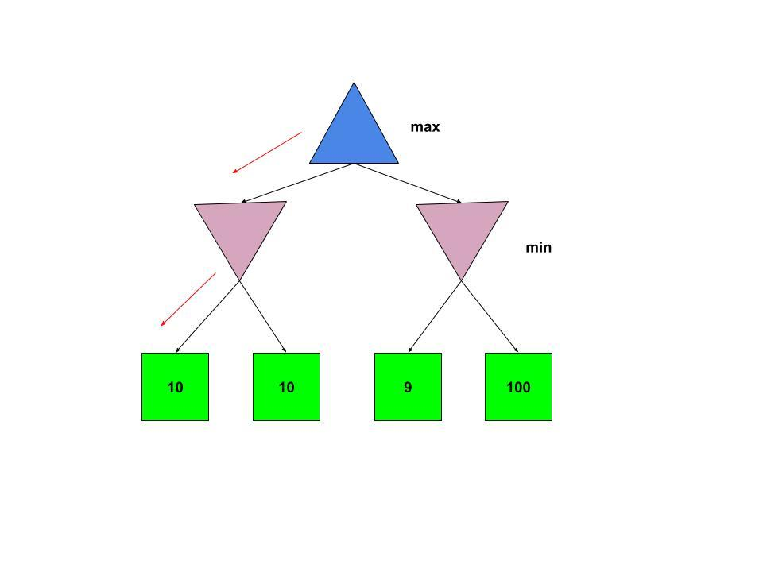
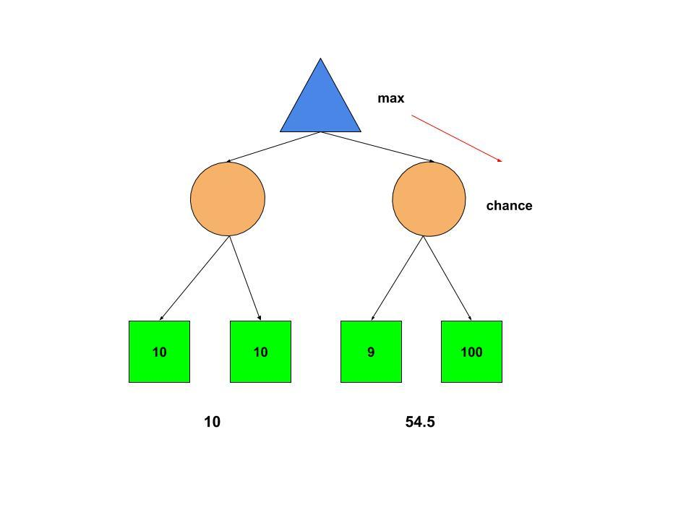
Expectimax
Maximizes expected utility
Does not assume opponent plays optimally
Replaces MIN nodes with CHANCE nodes
CHANCE averages the UTILITIES of child nodes

Slide 15
Expectimax Search
Why wouldn’t we know what the result of an action will be?
Explicit randomness: rolling dice
Unpredictable opponents: the ghosts respond randomly
Actions can fail: when moving a robot, wheels might slip
Values should now reflect average-case (expectimax) outcomes, not worst-case (minimax) outcomes
Expectimax search: compute the average score under optimal play
Max nodes as in minimax search
Chance nodes are like min nodes but the outcome is uncertain
Calculate their expected utilities
I.e. take weighted average (expectation) of children
Later, we’ll learn how to formalize the underlying uncertain-result problems as Markov Decision Processes
max
chance
10
10
4
10
5
9
7
100
[Demo: min vs exp (L7D1,2)]

Slide 16

Expectimax vs Minimax
Advantages
Disadvantages
Expectimax algorithm helps take advantage of non-optimal opponents.
Unlike Minimax, Expectimax ‘can take a risk’ and end up in a state with a higher utility as opponents are suboptimal.
Expectimax is not optimal
MAX may lose
Requires the full search tree, no pruning possible
Sensitive to monotonic transformations in utility values
Magnitudes of the evaluation function values matter
In minimax, only ordering matters

Slide 17
Expectimax Pseudocode
def value(state):
if the state is a terminal state: return the state’s utility
if the next agent is MAX: return max-value(state)
if the next agent is EXP: return exp-value(state)
def max-value(state):
initialize v = -∞
for each successor of state:
v = max(v, value(successor))
return v
def exp-value(state):
initialize v = 0
for each successor of state:
p = probability(successor)
v += p * value(successor)
return v

Slide 18
Expectimax Pseudocode
def exp-value(state):
initialize v = 0
for each successor of state:
p = probability(successor)
v += p * value(successor)
return v
1/2
1/6
1/3
5
8
7
24
-12
v = (1/2) (8) + (1/3) (24) + (1/6) (-12) = 10

Slide 19
Expectimax Example
3
12
9
2
4
6
15
6
0

Slide 20

Other Game Types

Slide 21

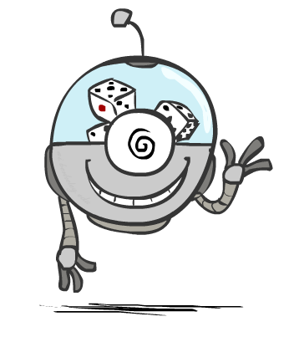


Mixed Layer Types
E.g. Backgammon
Expectiminimax
Environment is an extra “random agent” player that moves after each min/max agent
Each node computes the appropriate combination of its children

Slide 22
Expectiminimax
function decision(s) returns an action
return the action a in Actions(s) with the highest value(Result(s,a))
function value(s) returns a value
if Terminal_Test(s) then return Utility(s)
if Player(s) = MAX then return max_{a in Actions(s)} value(Result(s,a))
if Player(s) = MIN then return min_{a in Actions(s)} value(Result(s,a))
if Player(s) = CHANCE then return sum_{a in Actions(s)} Pr(a) * value(Result(s,a))
Notes:
Note that “minimax-decision” has become just “decision”

Slide 23
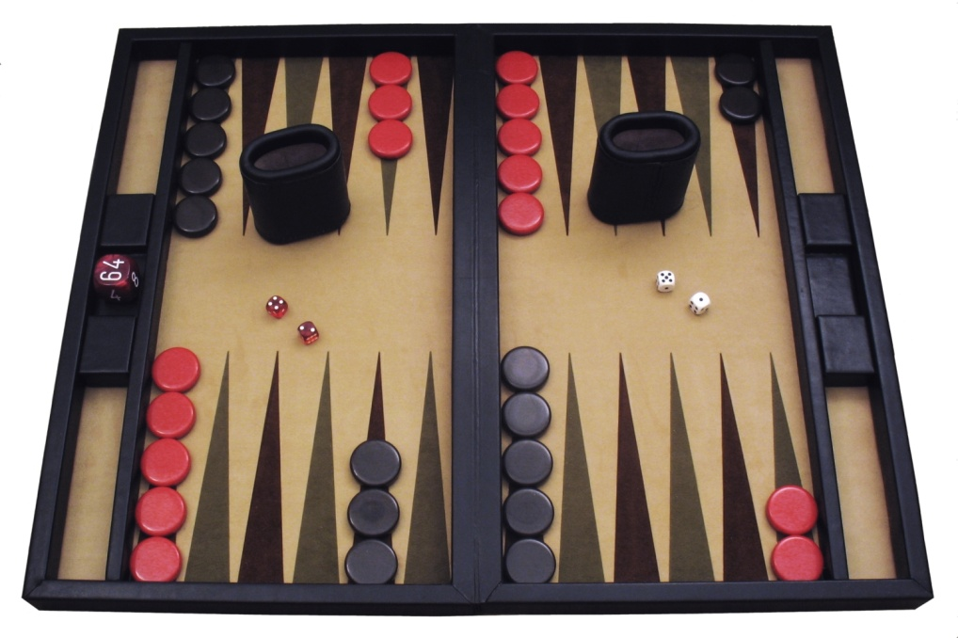
Example: Backgammon
Dice rolls increase b: 21 possible rolls with 2 dice
Backgammon ≈ 20 legal moves
4 plies = 20 x (21 x 20)³ = 1.2 x 10⁹
As depth increases, probability of reaching a given search node shrinks
So usefulness of search is diminished
So limiting depth is less damaging
But pruning is trickier…
Historic AI: TDGammon uses depth-2 search + very good evaluation function + reinforcement learning: world-champion level play
Image: Wikipedia

Slide 24
What Values to Use?
0
40
20
30
x²
0
1600
400
900
For worst-case minimax reasoning, evaluation function:
scale doesn’t matter
order matters
Minimax decisions are invariant with respect to monotonic transformations on values
Expectiminimax decisions are invariant with respect to positive affine transformations
Expectiminimax evaluation functions must align with actual win probabilities!
x>y => f(x)>f(y)
f(x) = Ax+B where A>0
Notes:
Notice the processes of:
Refining evaluation functions
Relaxing evaluation functions
Generalizing algorithms

Slide 25

Monte Carlo

Slide 26
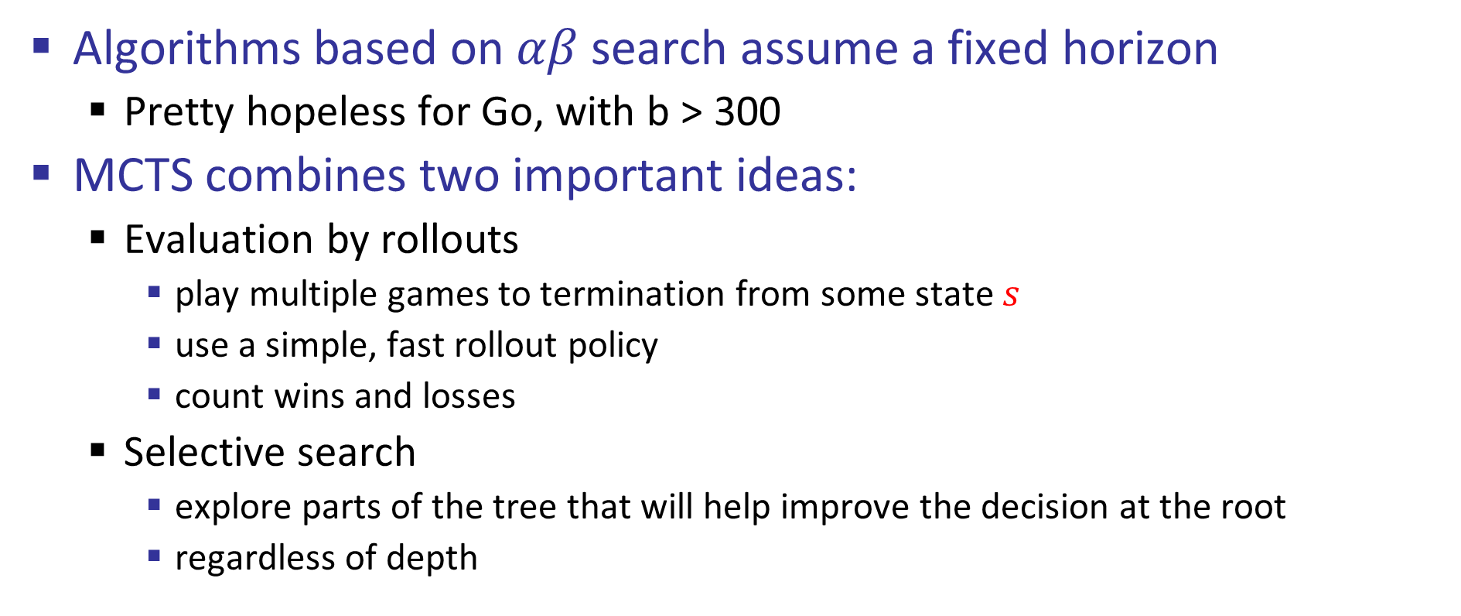
Monte Carlo Tree Search
Algorithms based on $αβ$ search assume a fixed horizon
Pretty hopeless for Go, with b > 300
MCTS combines two important ideas:
Evaluation by rollouts
play multiple games to termination from some state $s$
use a simple, fast rollout policy
count wins and losses
Selective search
explore parts of the tree that will help improve the decision at the root
regardless of depth

Slide 27
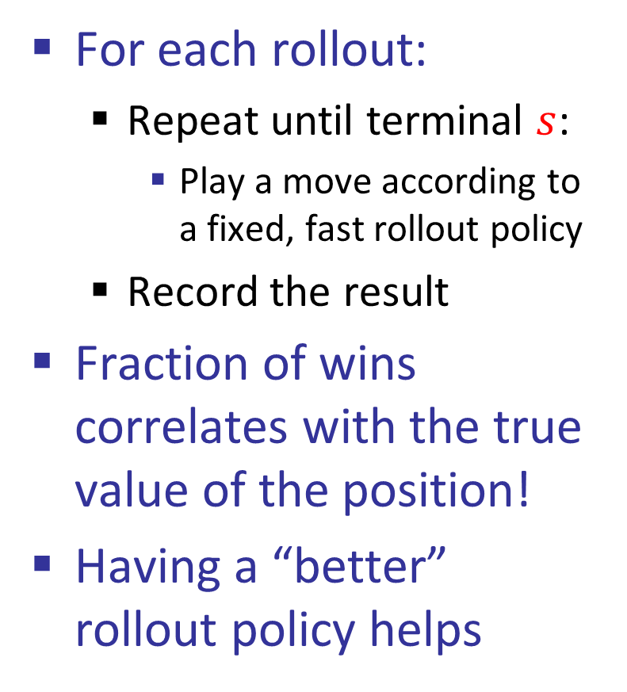
Rollout aka Playout
“Move 37”
For each rollout:
Repeat until terminal $s$:
Play a move according to a fixed, fast rollout policy
Record the result
Fraction of wins correlates with the true value of the position!
Having a “better” rollout policy helps

Slide 28
MCTS Version 0 (I)
Do N rollouts from each child of the root, record fraction of wins
Pick the move that gives the best outcome by this metric
Important that each (state, action) transition gets evaluated enough times
57/100
39/100
65/100
Notes:
Important that each state,action transition gets evaluated enough times.

Slide 29
MCTS Version 0 (II)
Do N rollouts from each child of the root, record fraction of wins
Pick the move that gives the best outcome by this metric
57/100
0/100
59/100

Slide 30
Biased MCTS Version 0.9
Allocate rollouts to more promising nodes
77/140
0/10
90/150

Slide 31
Biased MCTS Version 0.9 (II)
Allocate rollouts to more promising nodes
61/100
6/10
48/100

Slide 32
MCTS Version 1.0
Allocate rollouts to more promising nodes: exploit
Allocate rollouts to more uncertain nodes: explore
61/100
6/10
48/100

Slide 33
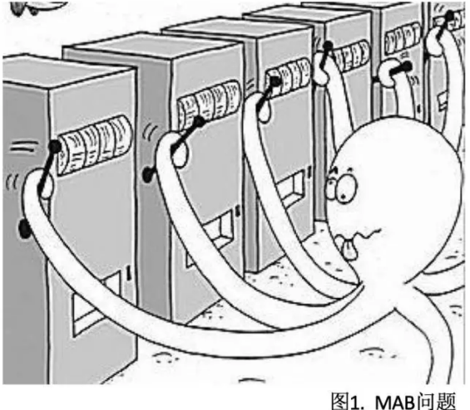
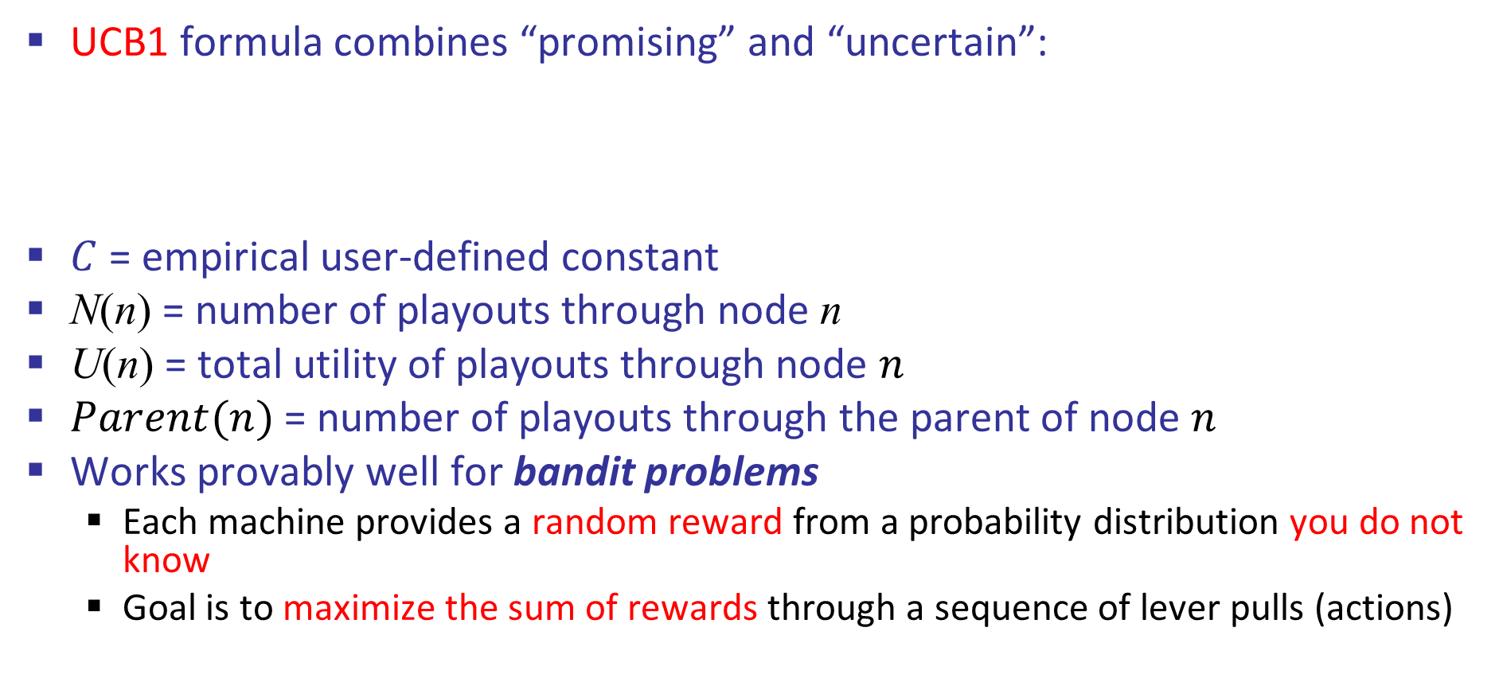
UCB heuristics
UCB1 formula combines “promising” and “uncertain”:
$C$= empirical user-defined constant
N(n) = number of playouts through node n
U(n) = total utility of playouts through node $n$
$Parent(n)$= number of playouts through the parent of node $n$
Works provably well for bandit problems
Each machine provides a random reward from a probability distribution you do not know
Goal is to maximize the sum of rewards through a sequence of lever pulls (actions)
Exploit
Explore
Multi Arm bandit
Notes:
UCB: Upper Confidence Bound
UCT: Upper Confidence Bound Applied to Trees

Slide 34
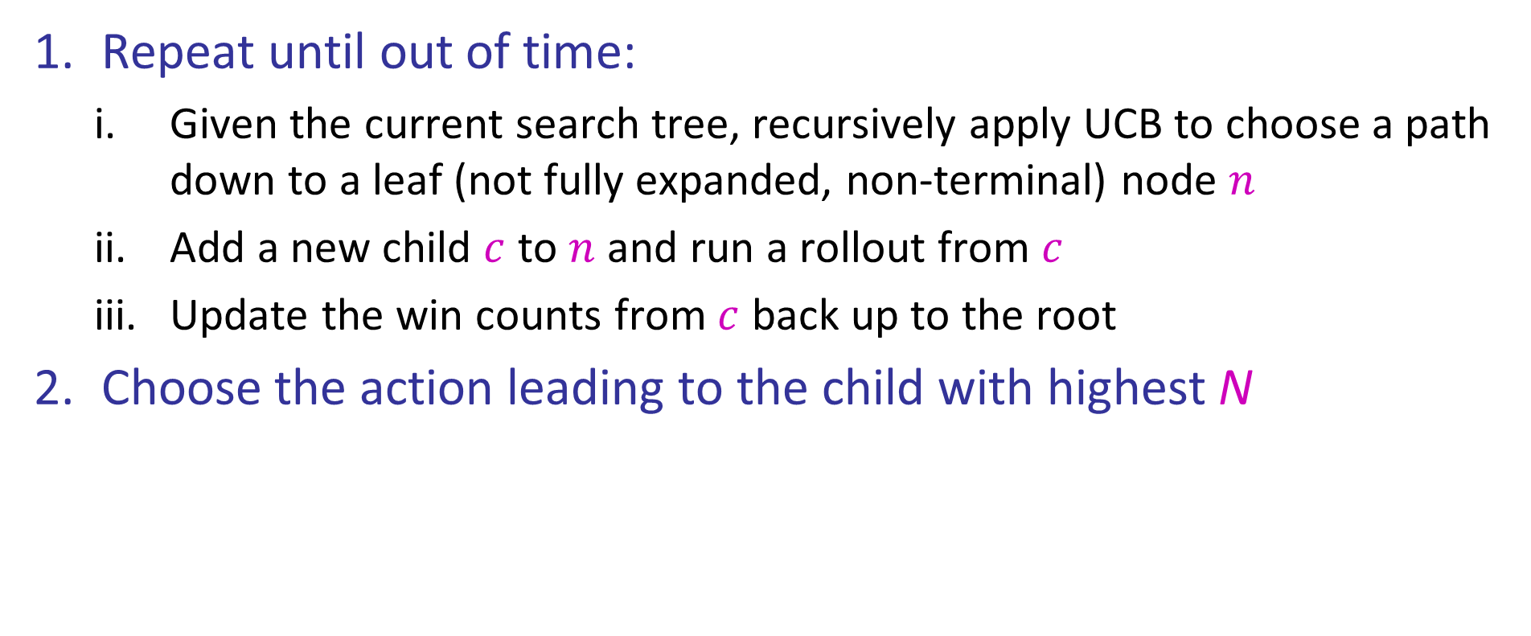
MCTS Version 2.0: UCT
Repeat until out of time:
Given the current search tree, recursively apply UCB to choose a path down to a leaf (not fully expanded, non-terminal) node $n$
Add a new child $c$ to $n$ and run a rollout from $c$
Update the win counts from $c$ back up to the root
Choose the action leading to the child with highest N

Slide 35
UCT Example
5/10
4/9
4/7
1/2
0/1
0/1
2/3
0/1
2/2
1/1

Slide 36
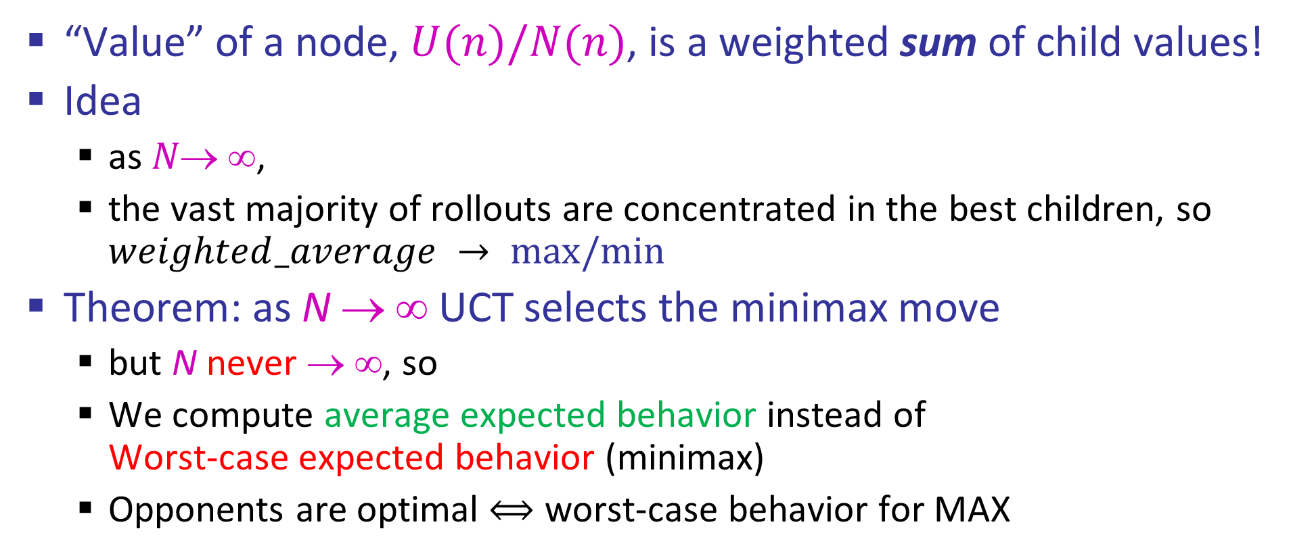
Why is there no min or max?????
“Value” of a node, $U(n)/N(n)$, is a weighted sum of child values!
Idea
as $N\text{→} \text{∞}$,
the vast majority of rollouts are concentrated in the best children, so $weighted_average → max/min⁡$
Theorem: as N → ∞ UCT selects the minimax move
but N never → ∞, so
We compute average expected behavior instead of Worst-case expected behavior (minimax)
Opponents are optimal $⟺$ worst-case behavior for MAX

Slide 37
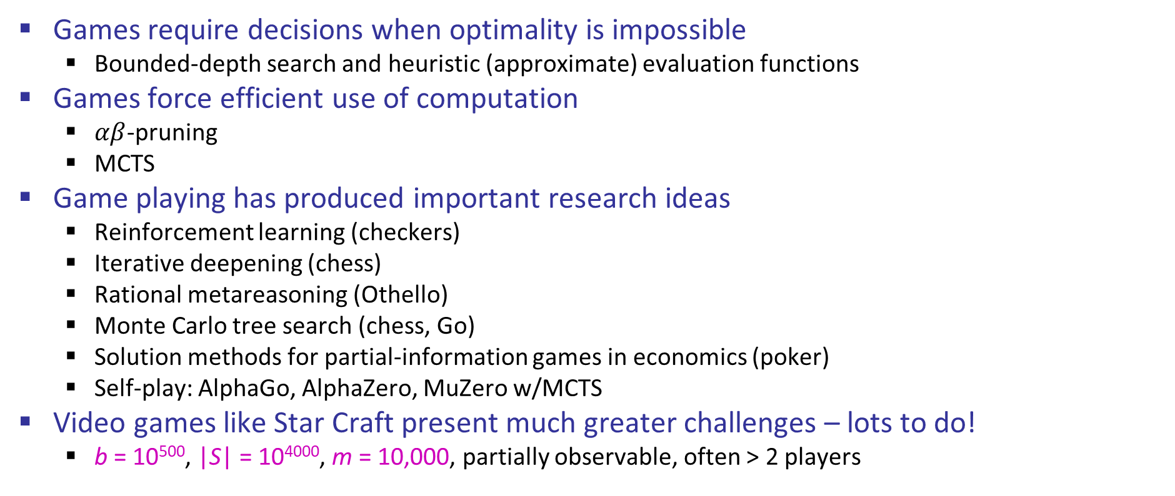
Summary
Games require decisions when optimality is impossible
Bounded-depth search and heuristic (approximate) evaluation functions
Games force efficient use of computation
$αβ$-pruning
MCTS
Game playing has produced important research ideas
Reinforcement learning (checkers)
Iterative deepening (chess)
Rational metareasoning (Othello)
Monte Carlo tree search (chess, Go)
Solution methods for partial-information games in economics (poker)
Self-play: AlphaGo, AlphaZero, MuZero w/MCTS
Video games like Star Craft present much greater challenges – lots to do!
b = 10⁵⁰⁰, |S| = 10⁴⁰⁰⁰, m = 10,000, partially observable, often > 2 players

Slide 38
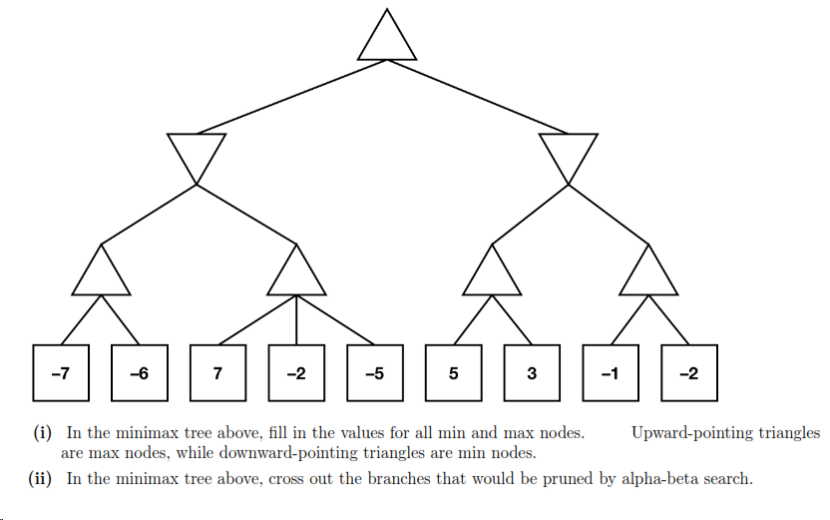
Example

Slide 39
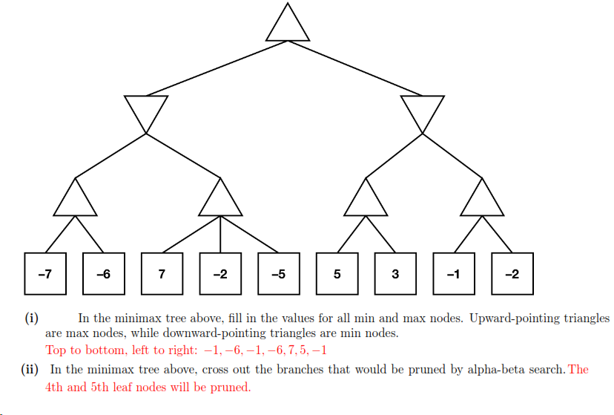
Example (Solution)

